Slide 1



Climate crisis
The role of fashion

Slide 2
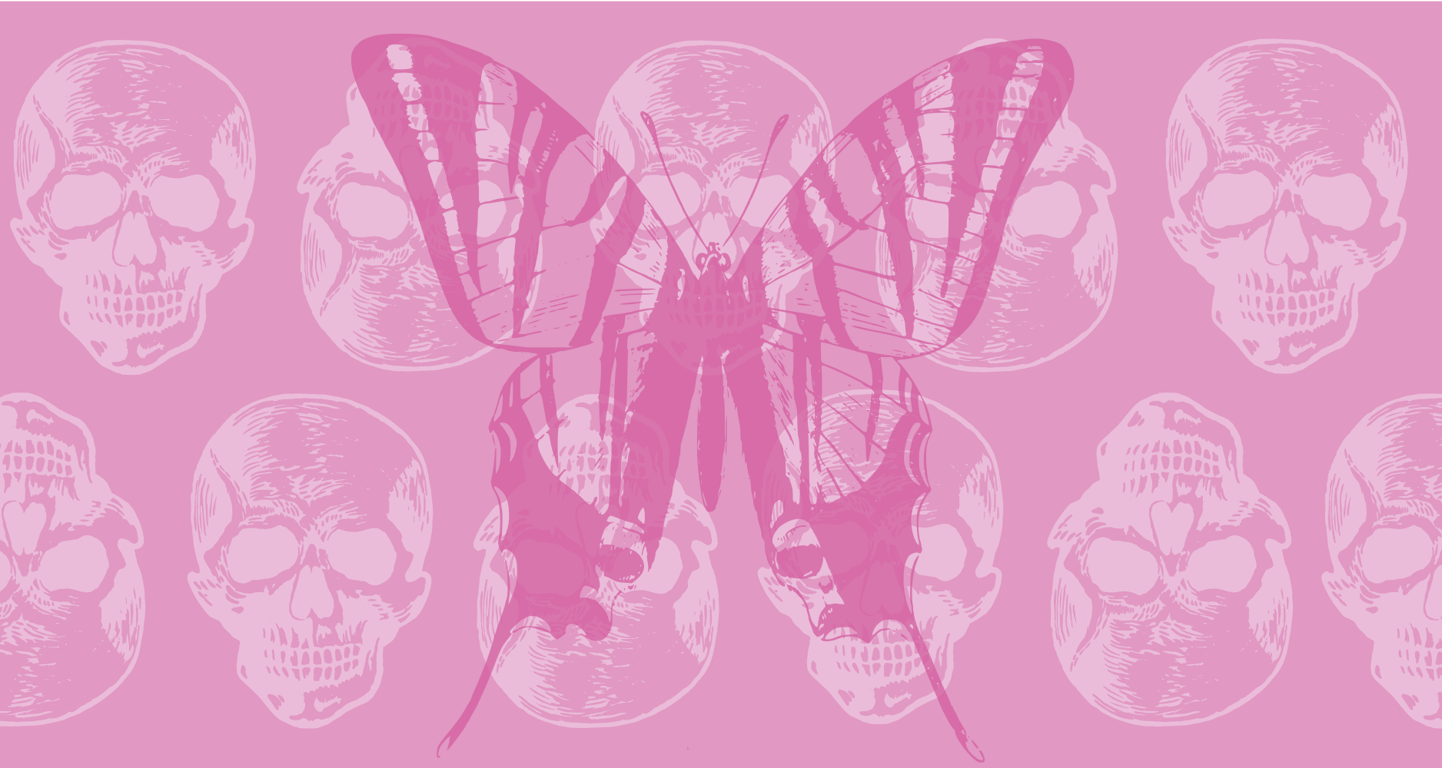
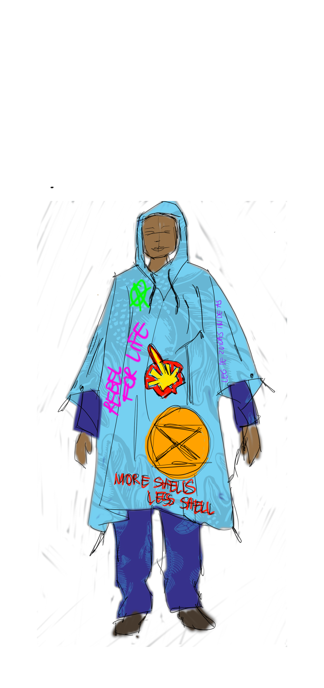
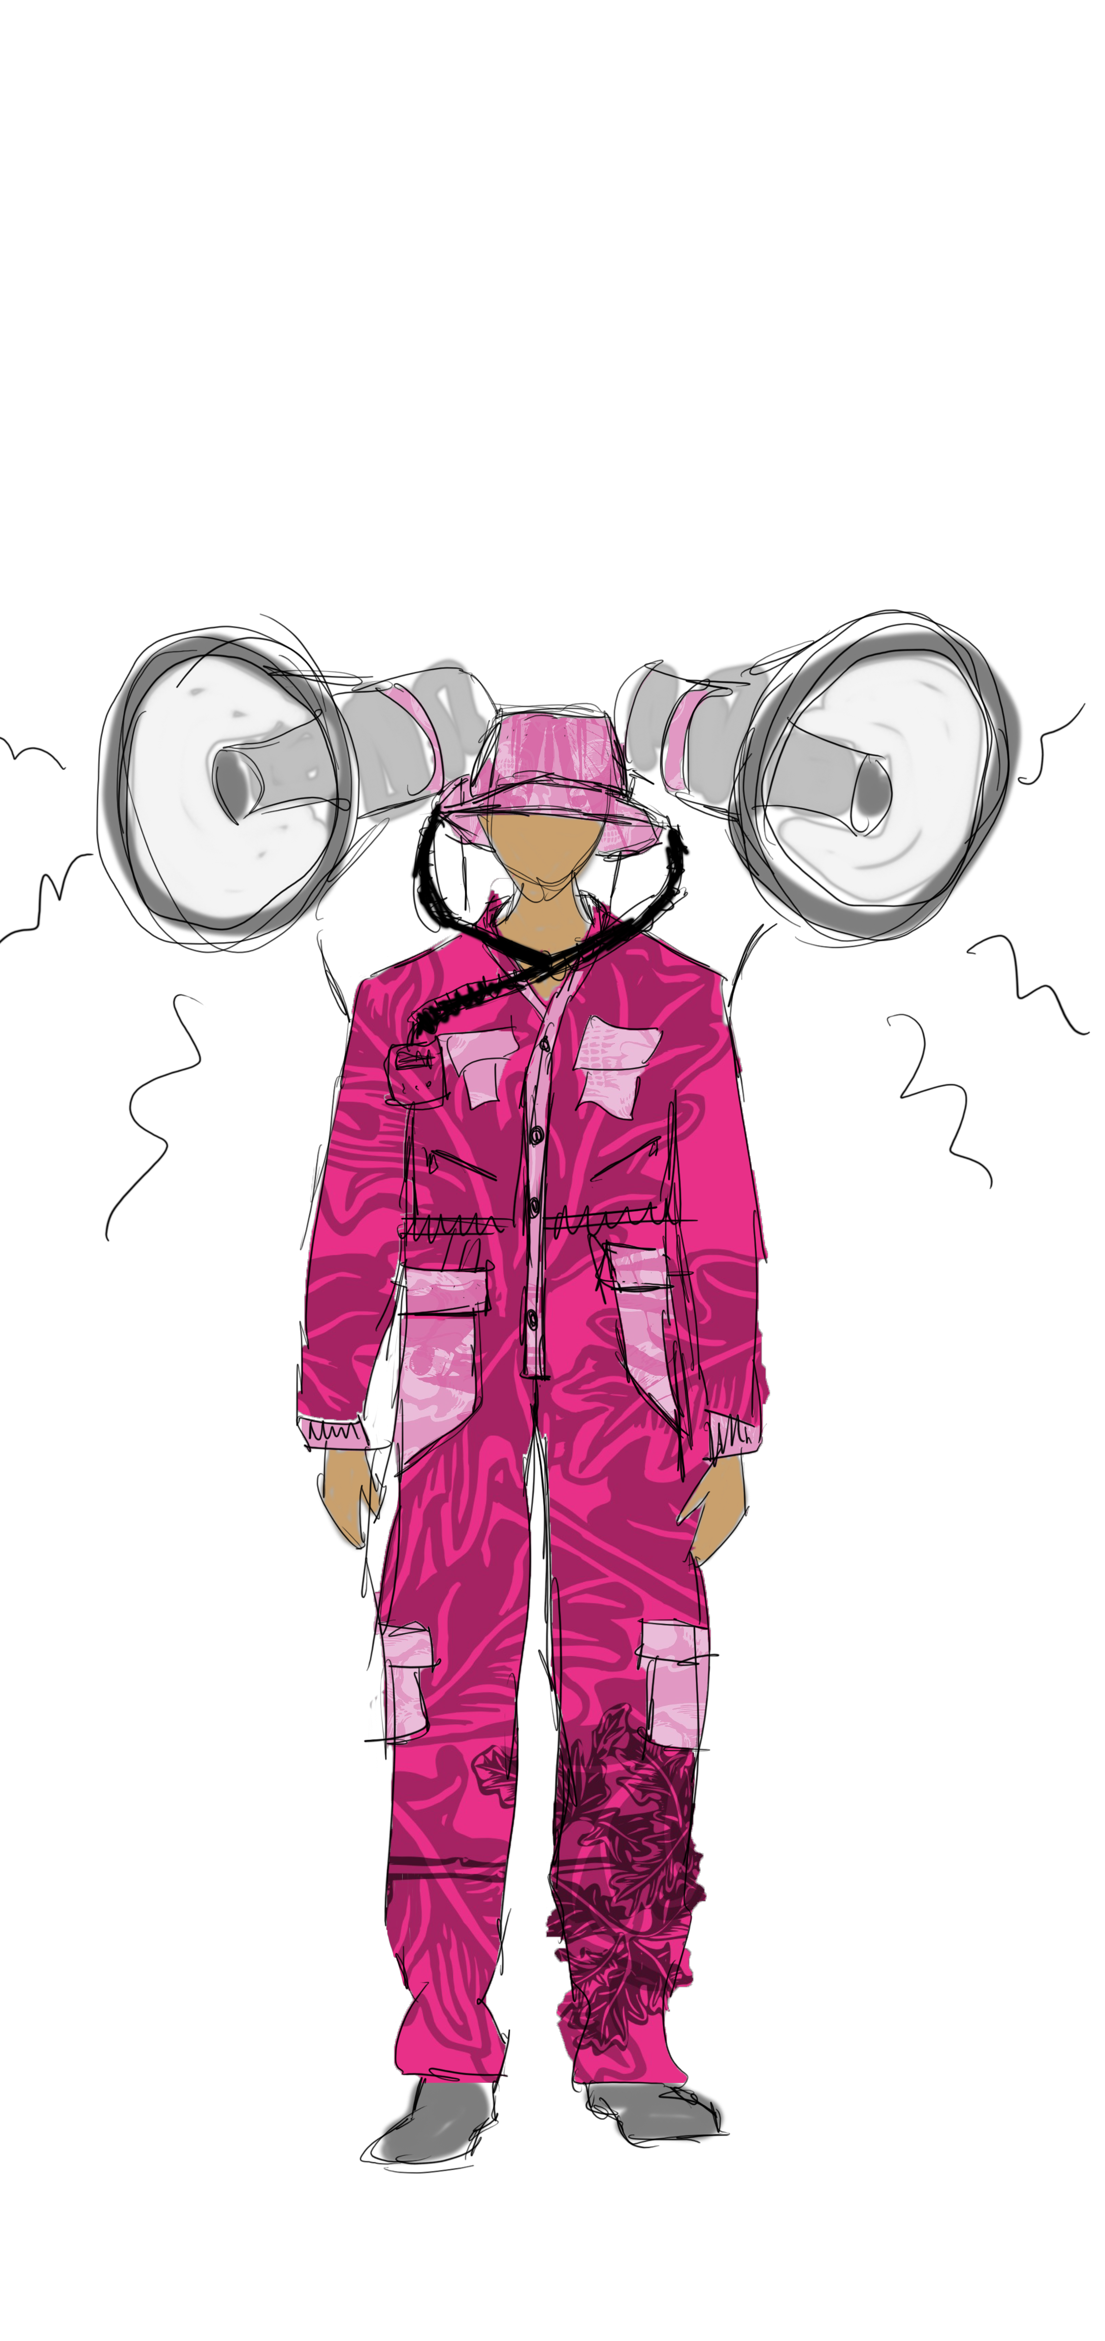
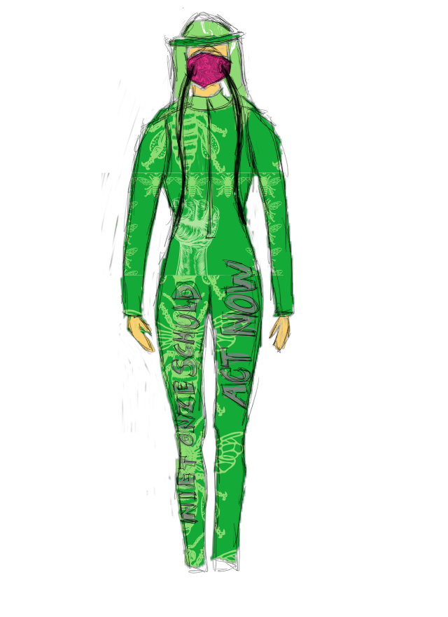
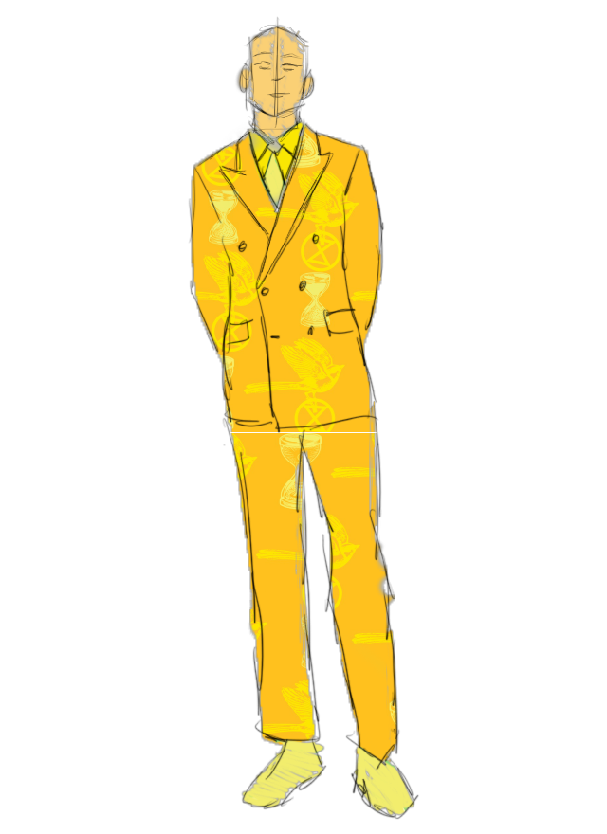
What
Biodegradable collection that can be worn during an Extinction Rebellion blockade

Slide 3


Why
Fashion fossil fuel Facts
39,5 – 44,5 billion euros in fossil fuel subsidies
Synthetic materials like rayon, nylon, and polyester make up nearly 64% of all apparel and are made from fossil fuels, such as oil and gas (1)
C&A, the biggest Dutch fashion company, has 26% of its garments based on synthetics only (we don’t know how many blends they have, nor their vision on finishings) (2)
G-Star Raw uses 15% of synthetic materials (2)
Extinction rebellion
Climate justice for all
Tell the truth
Act now
Decide together
(1) https://quantis.com/wp-content/uploads/2019/11/measuringfashion_globalimpactstudy_quantis_2018.pdf; (2) http://changingmarkets.org/wp-content/uploads/2021/07/SyntheticsAnonymous_FinalWeb.pdf

Slide 4
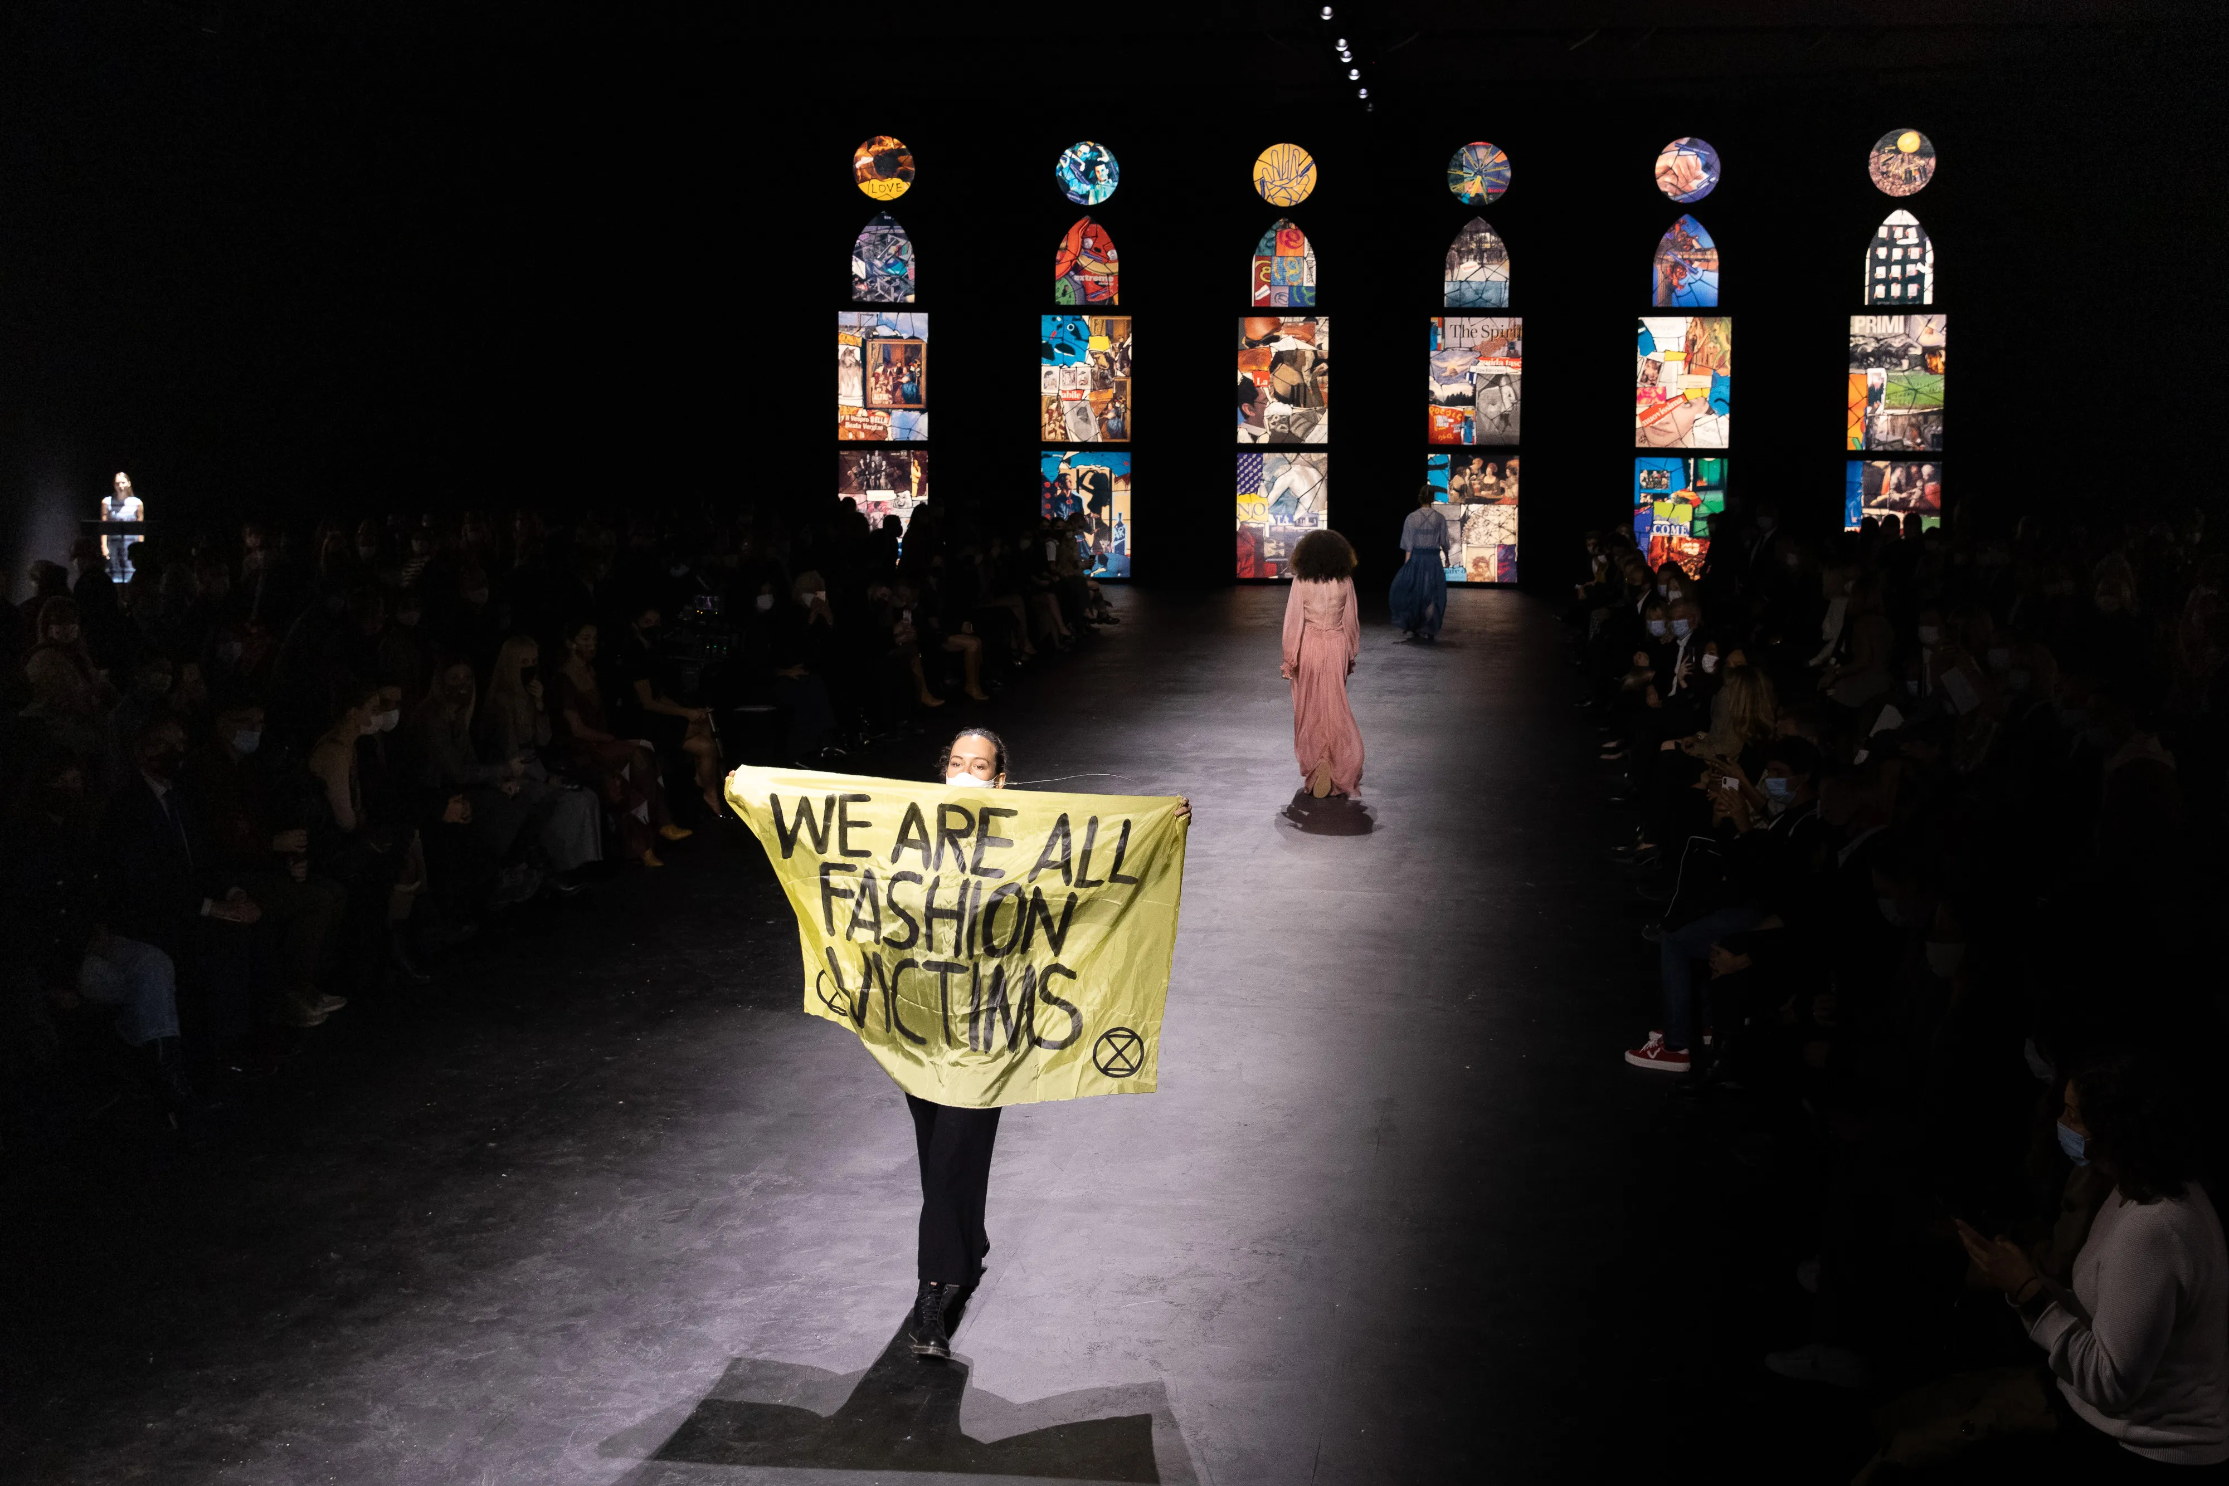
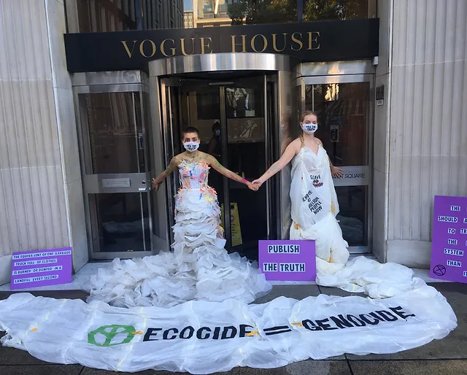
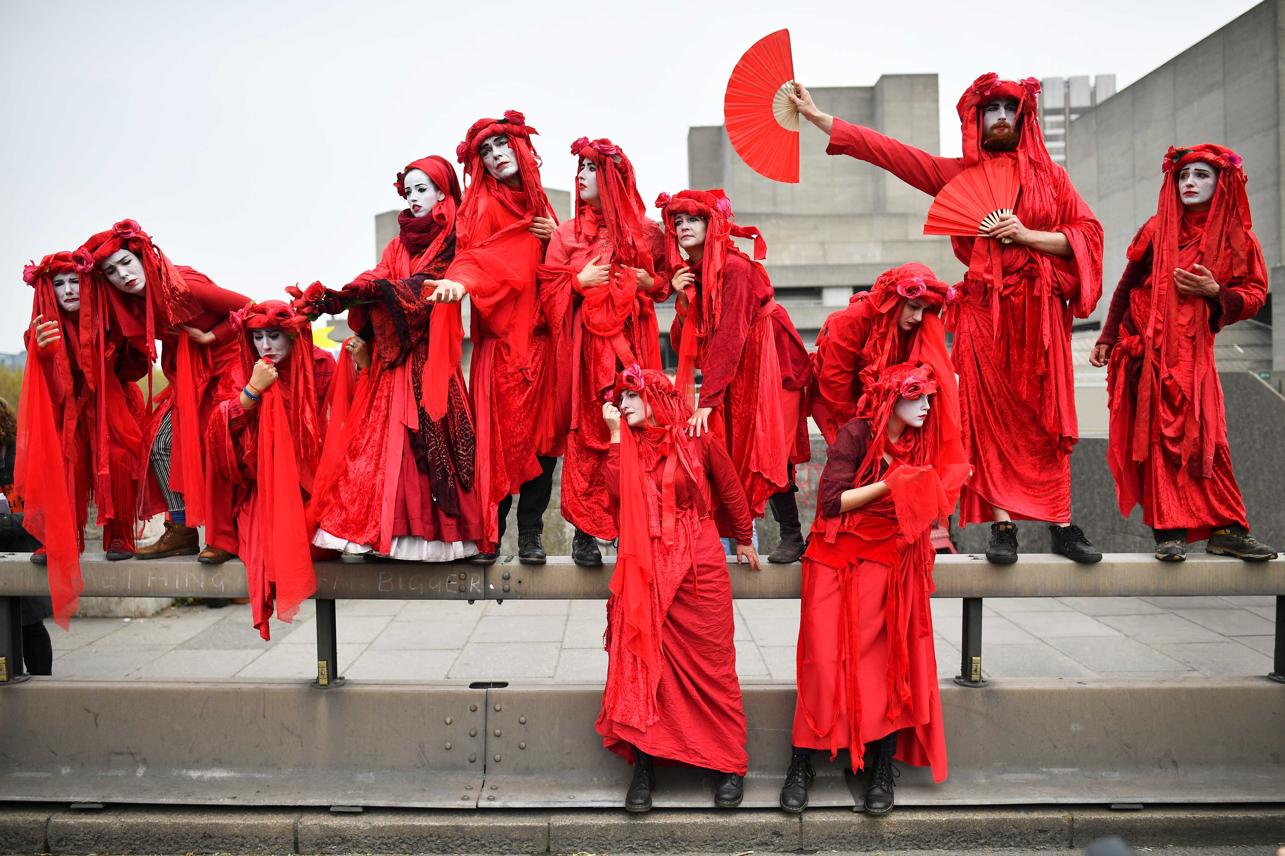
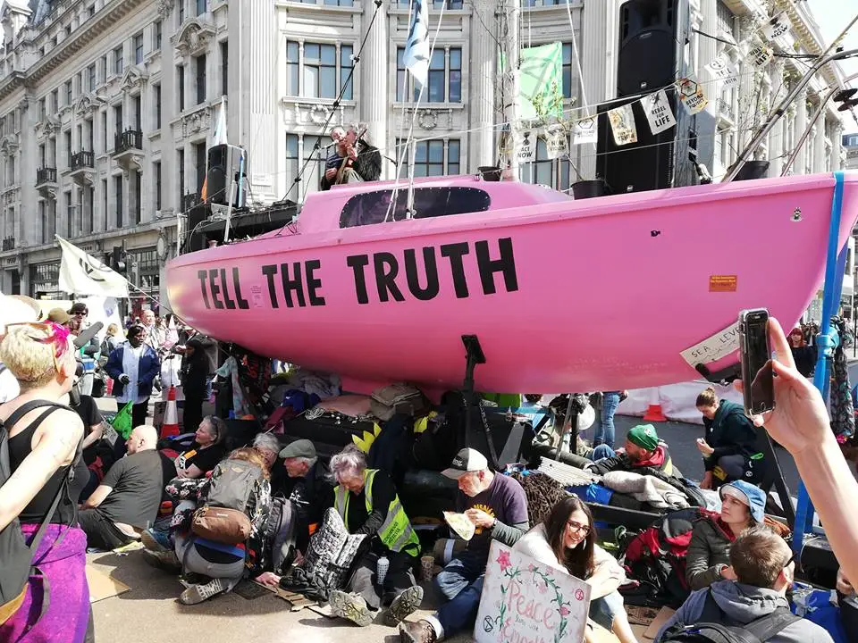
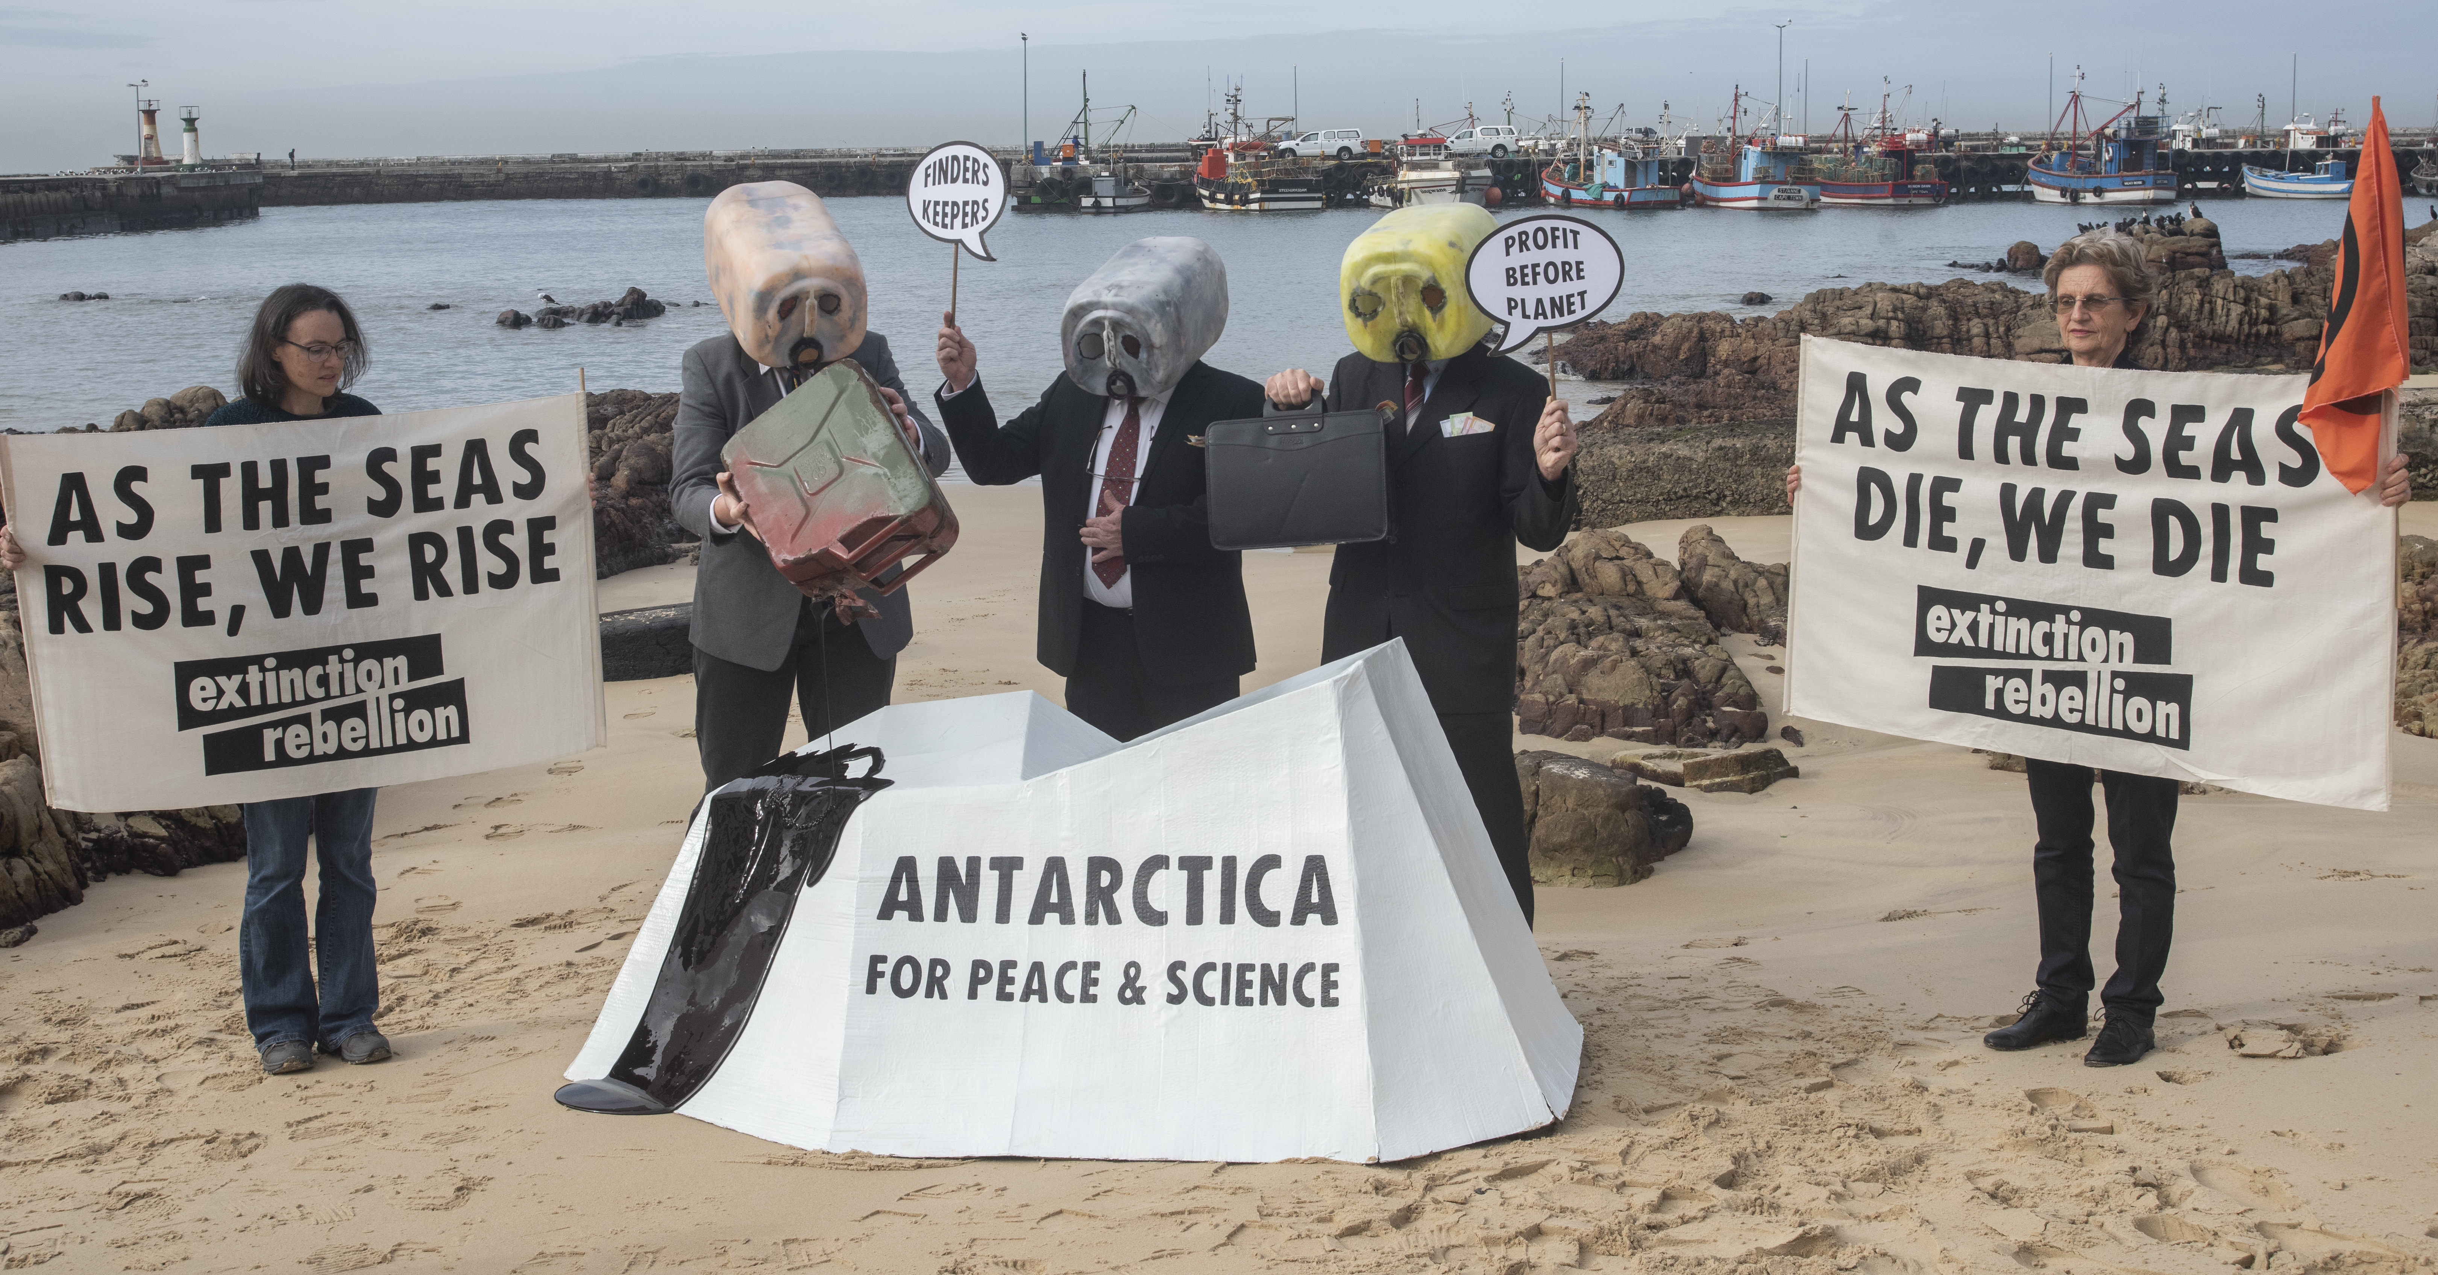
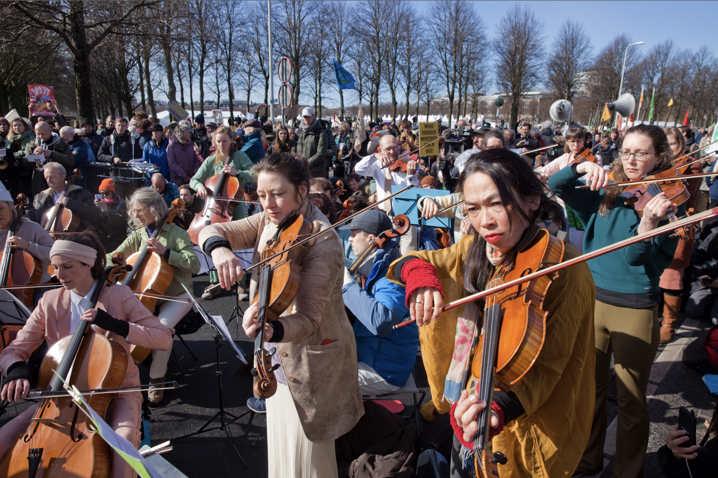
Why
Room for Artivism

Slide 5



How
Research, study and design
Attending the blockades
Rebel interviews
~
material research
~
Archetypical garment Study
~
Fashion design
Digitize materials

Slide 6

How
PLanning
Aug | Sept | Oct | Nov | Dec | Jan | Feb | Maart | April | Mei | Juni
Finished research paper | Finished Rebel Interviews | Finished little samples | Finished fabric recipes | Finished molds | Finished 3D samples of finishings | Finished big materials in molds | Finished design ideas (6 looks) | Finished toiles | Finished all digital designs | Finished physical look(s)
Finished website understanding for documentation | Finished research on civil disobedience | Finished understanding De Waag and machines |  | Finished color research | Finished archetypical garment study | Finished digitalising materials |  | Finished finishings for garments 3D printed | Finished line up + finished renders | Finished photoshoot and other deliverables

Slide 7
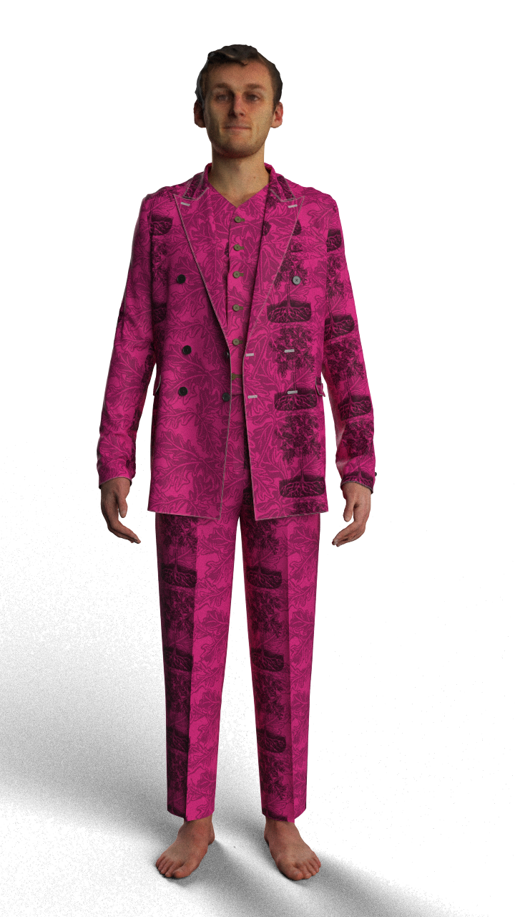
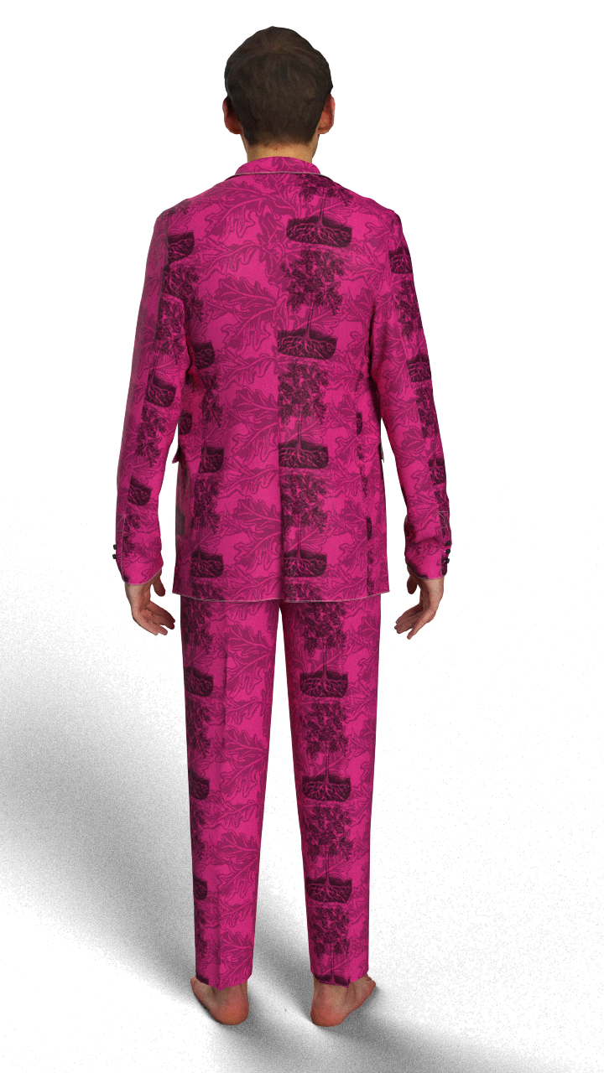
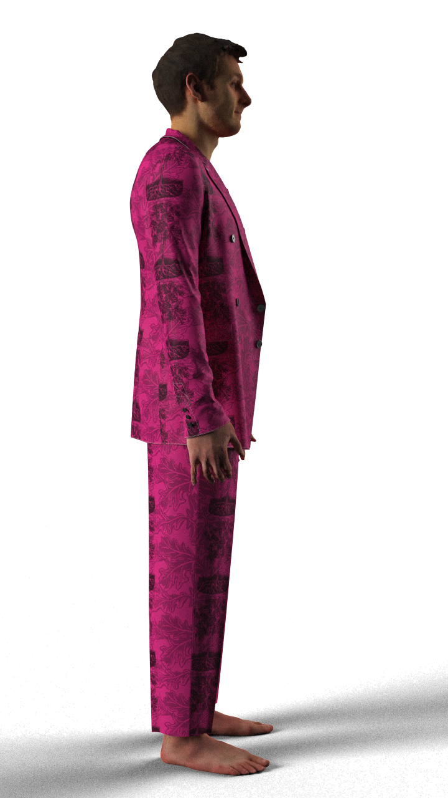
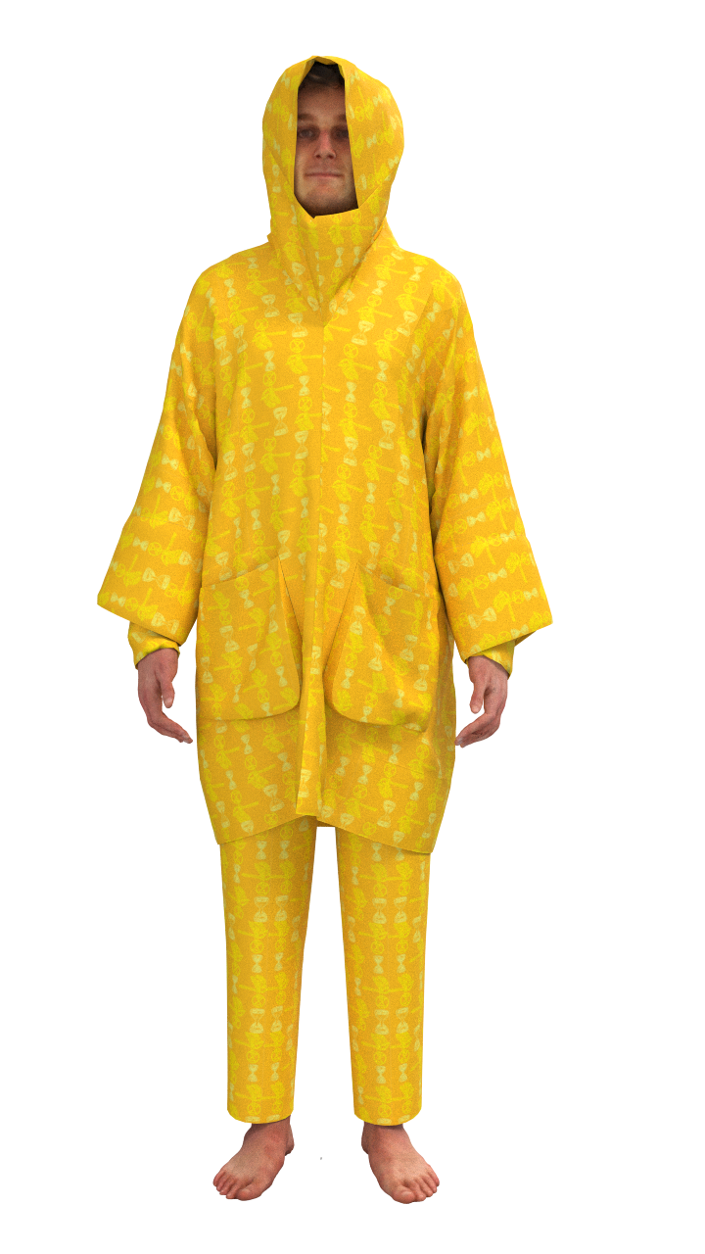
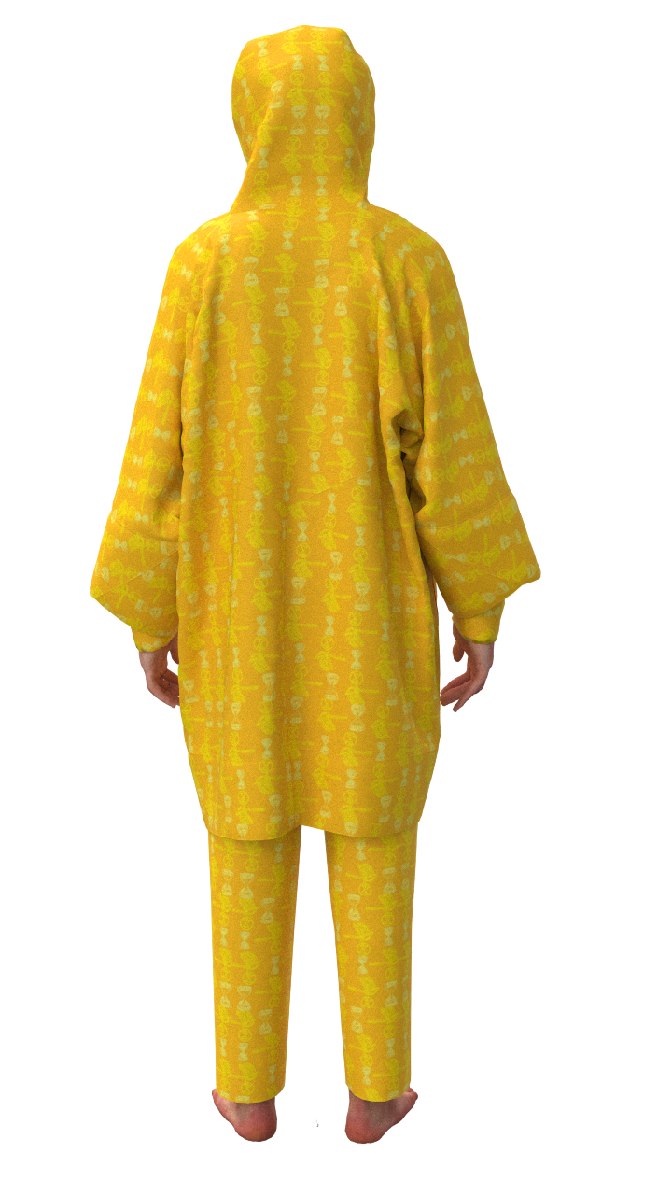
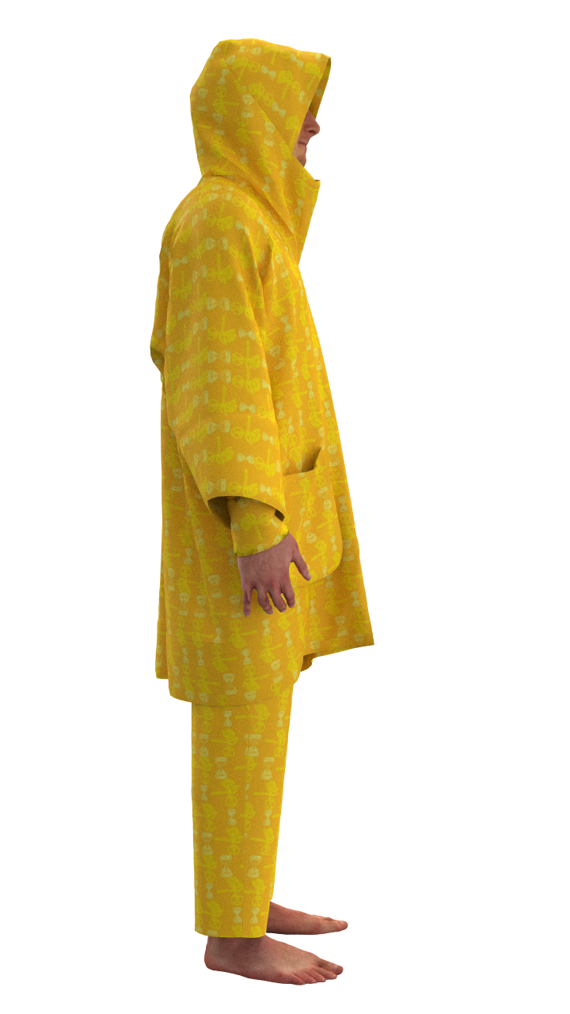
What
Biodegradable collection that can be worn during an Extinction Rebellion blockade

Slide 8
What, why, how
What
A phygital open source biodegradable collection that can be worn during and supports an Extinction Rebellion blockade
Why
We are living in a climate crisis. Extinction Rebellion is showing civil disobedience to enforce proper climate justice and policy. The freedom in form of protest of Extinction Rebellion causes the opportunity for artivism, like this collection. Biodegradable materials Extinction Rebellion due to the demand of Extinction Rebellion which is rooted in the ecological crisis whereas biomaterials can play a role in the solution of this same ecological crisis.
How
By researching bio degradable materials, attending A12 protests each weekend, interviewing rebels, study practical archetypes of garments, such as police wear and digitalizing the final biodegradable materials

